Slide 1
Containers and images

Slide 2
Lesson Objectives
Understand what containers are and how they differ from traditional virtualization.
Explain the benefits of using containers for application development and deployment.
Identify the key components of container technology, including container engines, images, and registries.
Deploy a simple application using Docker as a practical example of container technology.

Slide 3
Containers

Slide 4
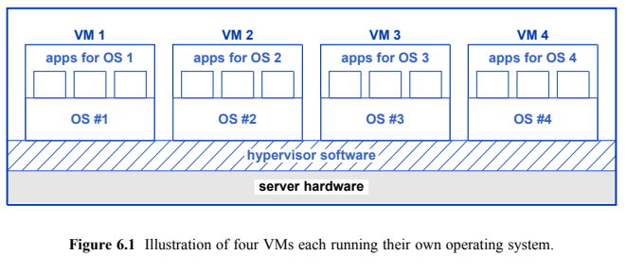
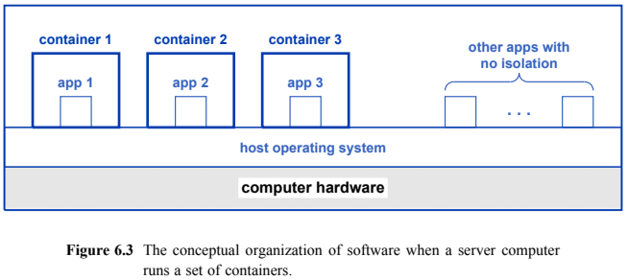
Spot the Difference

Slide 5
VM Overhead
VMs run their own operating system
Many VMs will have the same operating system (Linux, Windows, etc)
Each copy of the OS has a job scheduler, kernel, drivers, etc, etc
How can we eliminate overhead but keep the flexibility of VMs?

Slide 6
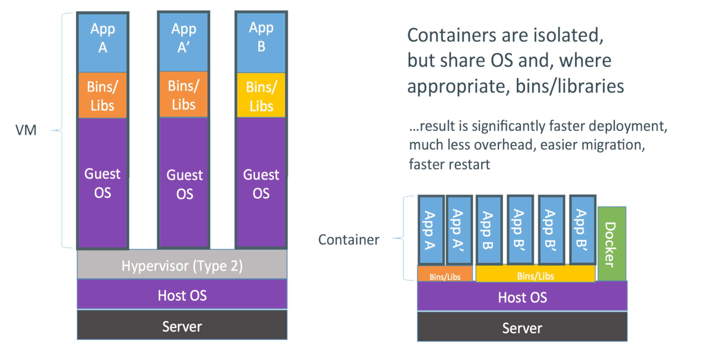
Containers
Surround an “app” in a “container”
The container is the boundaries of that app
The app believes it has a normal OS

Slide 7
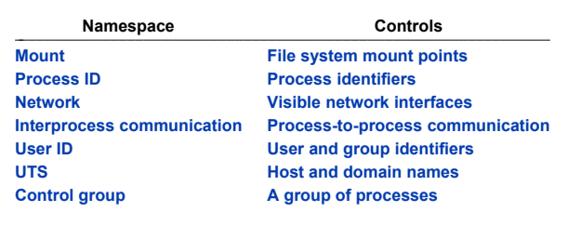
Isolation Mechanisms
Linux has a number of mechanisms to isolate processes from each other
Pre-existing and new concepts for containers

Slide 8
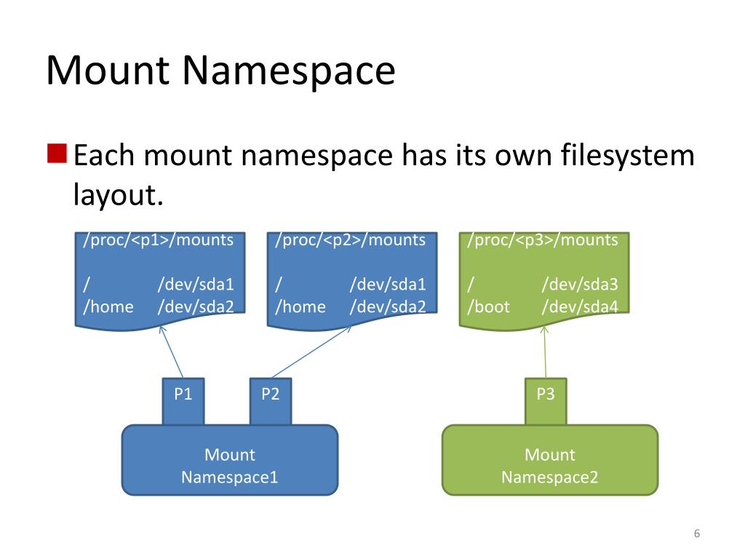
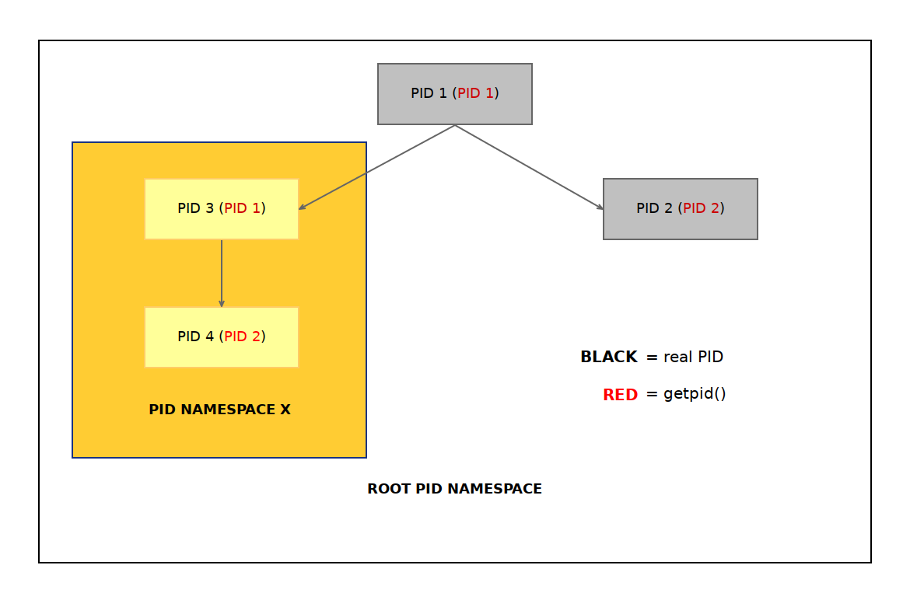
More On Namespaces
Process
Mount

Slide 9
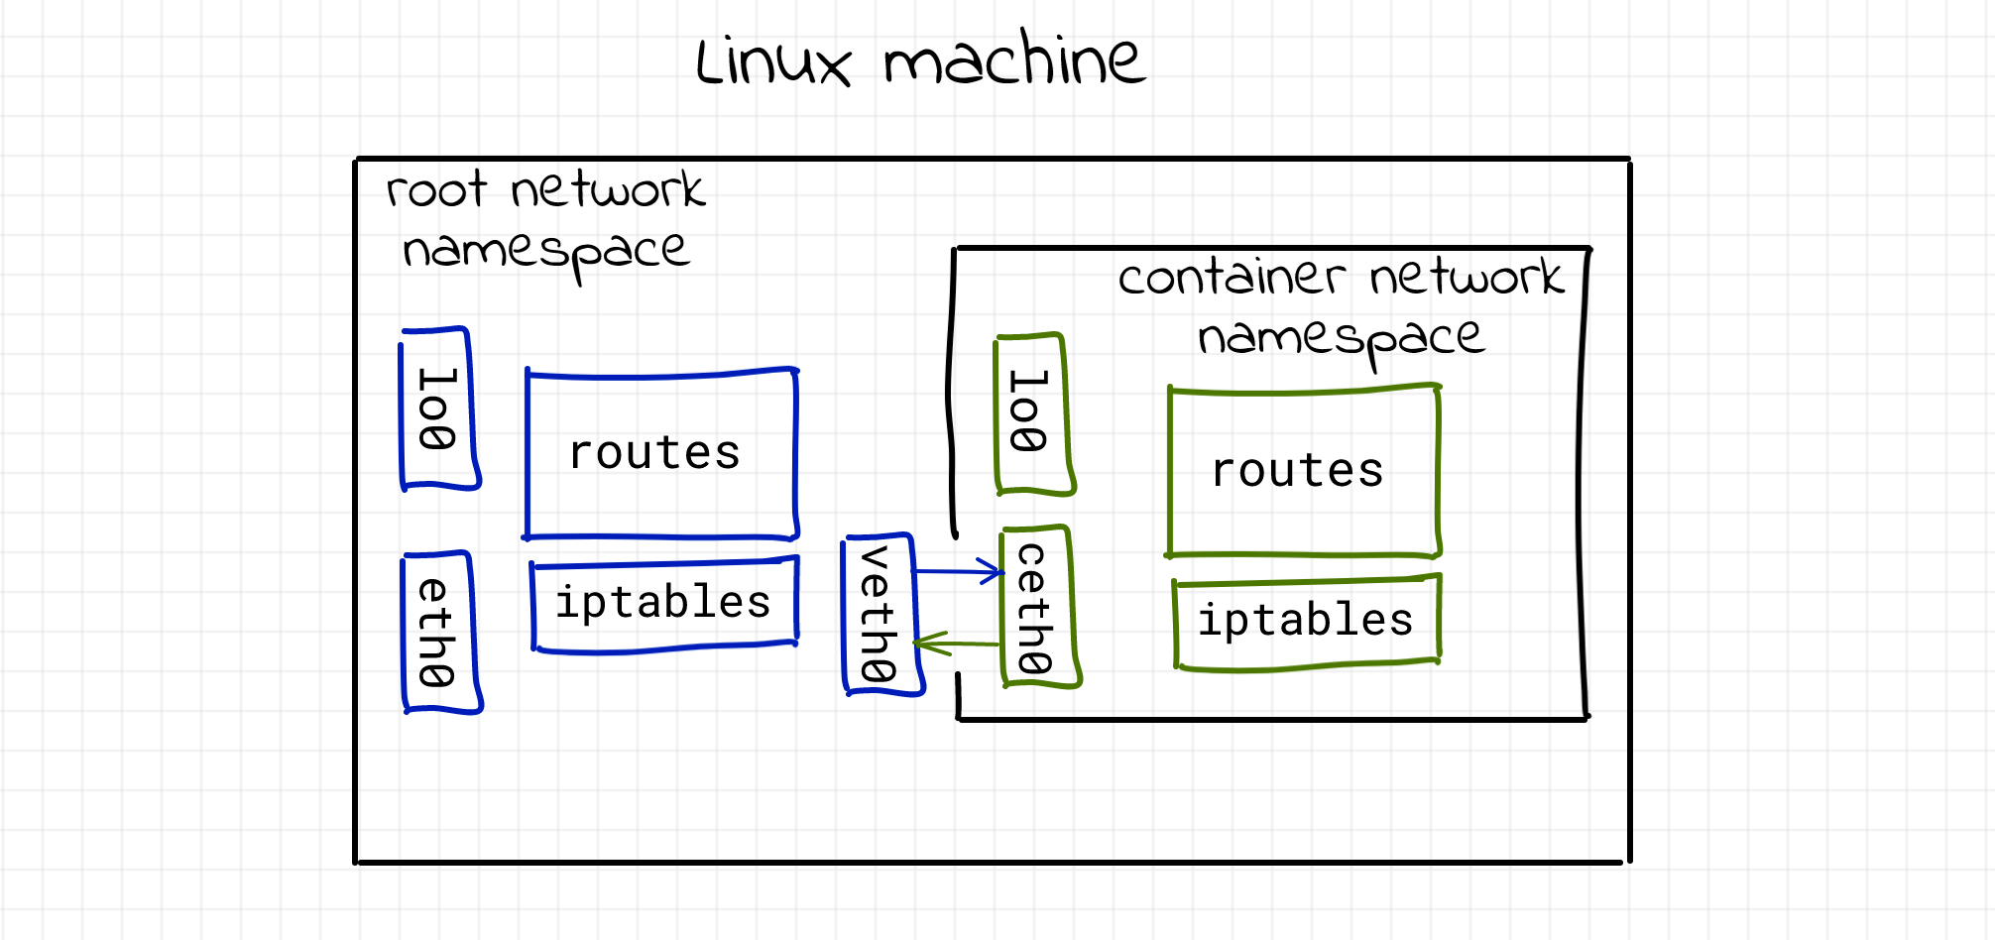
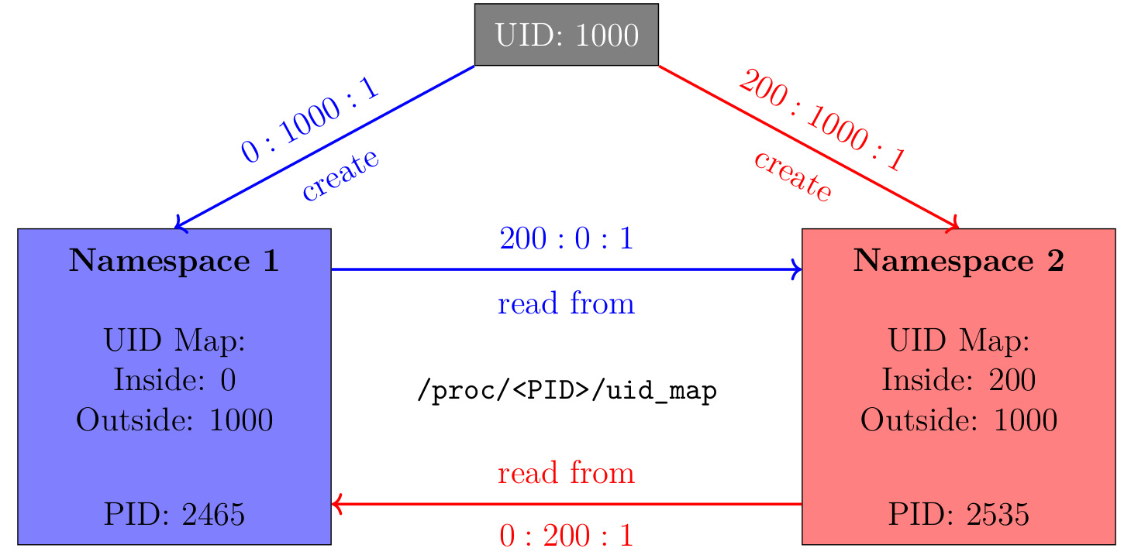
More On Namespaces
Network
User ID

Slide 10
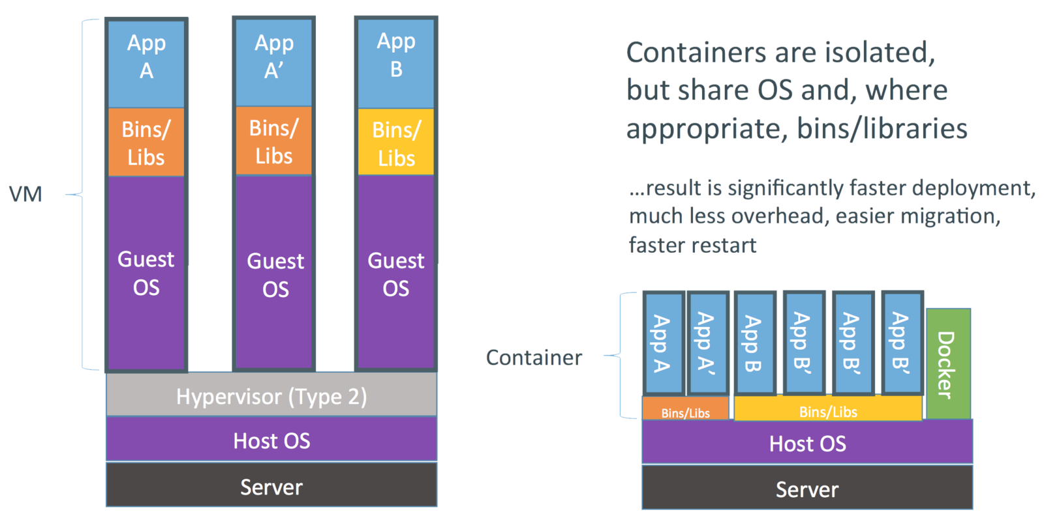
But wait…
Those namespaces look like a lot like overhead…

Slide 11
Other Container Considerations
Apps are built into “images”
Once an image is built, it is immutable
A container is one instantiation of that image
Any changes in a running container are temporary / non-persistent
Therefore… if we built image A,
how does image A compare to image A 3 months from now?
how does container A compare to image A 3 months form now?
how does container A now compare to container A 3 months from now?

Slide 12
Container Support
Engines, Images, Layers, Registries, Repositories

Slide 13
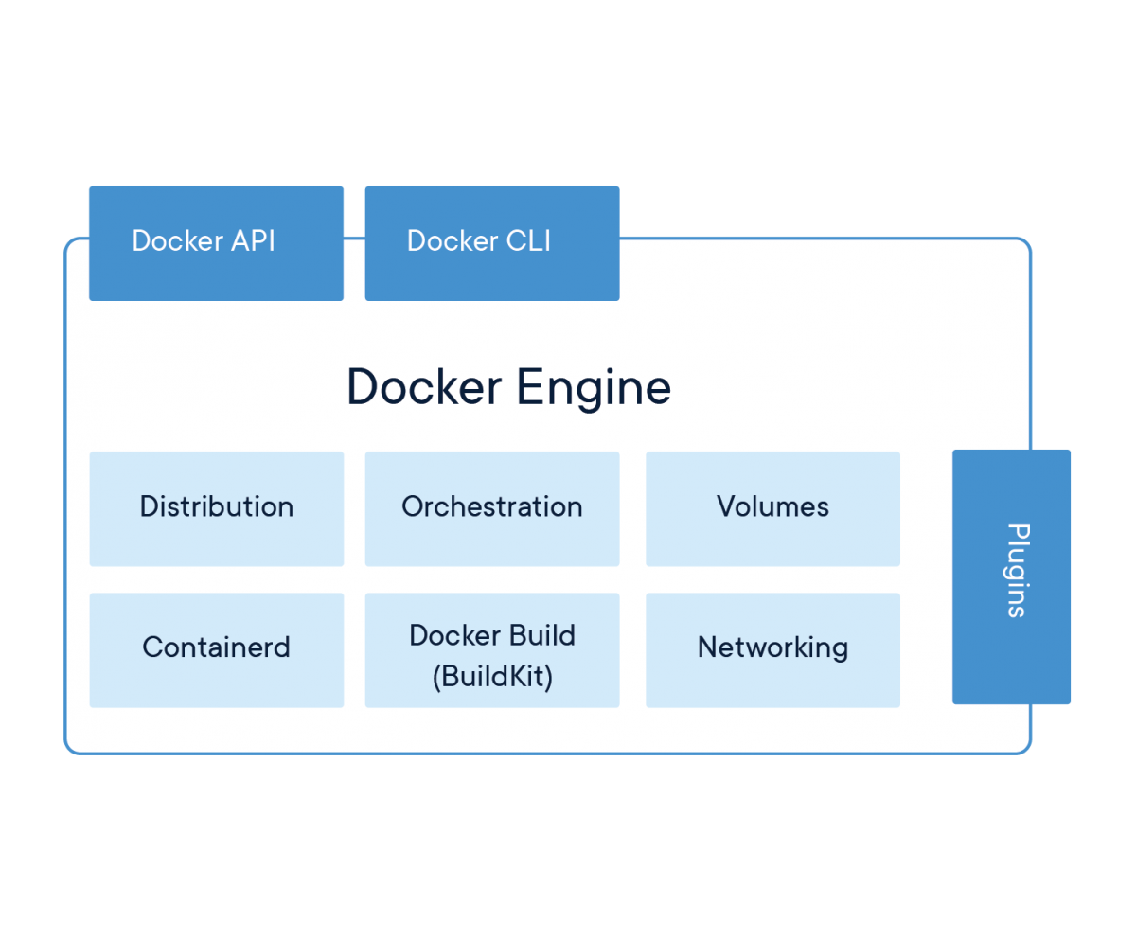
Container Engines
A daemon or process that interfaces between users and containers
dockerd, lxcd
Important role in making establishing namespaces / communication

Slide 14
Examples
lxd
dockerd
containerd
hyper-v

Slide 15
Container Image
A file (typically text or binary) that is used by the engine to start a container
The image is hashed and (optionally) signed to validate the image before running
Images are immutable after creation
Standardizing towards Open Container Initiative format

Slide 16
Onions…
Images are composed of layers
Layers are “stacked” on top of each other
The image specifies how to stack the layers
A layer includes multiple files
A layer may overwrite the contents of an earlier layer
We can hash the layers…

Slide 17
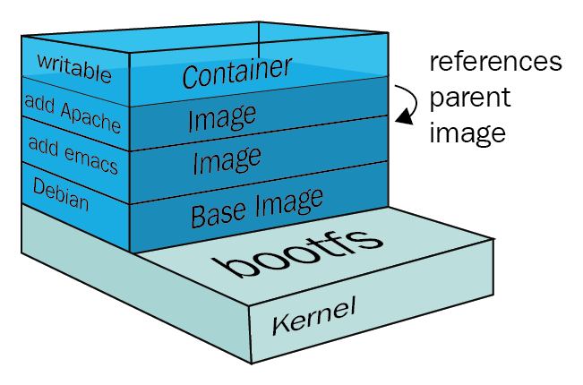
An Example

Slide 18
Repository & Namespaces & Registries
Repository – location that hosts container images (and their metadata)
Images are versioned (remember, immutable) by tag
Namespace – separates groups of repositories
Registry – location that hosts multiple repositories.

Slide 19
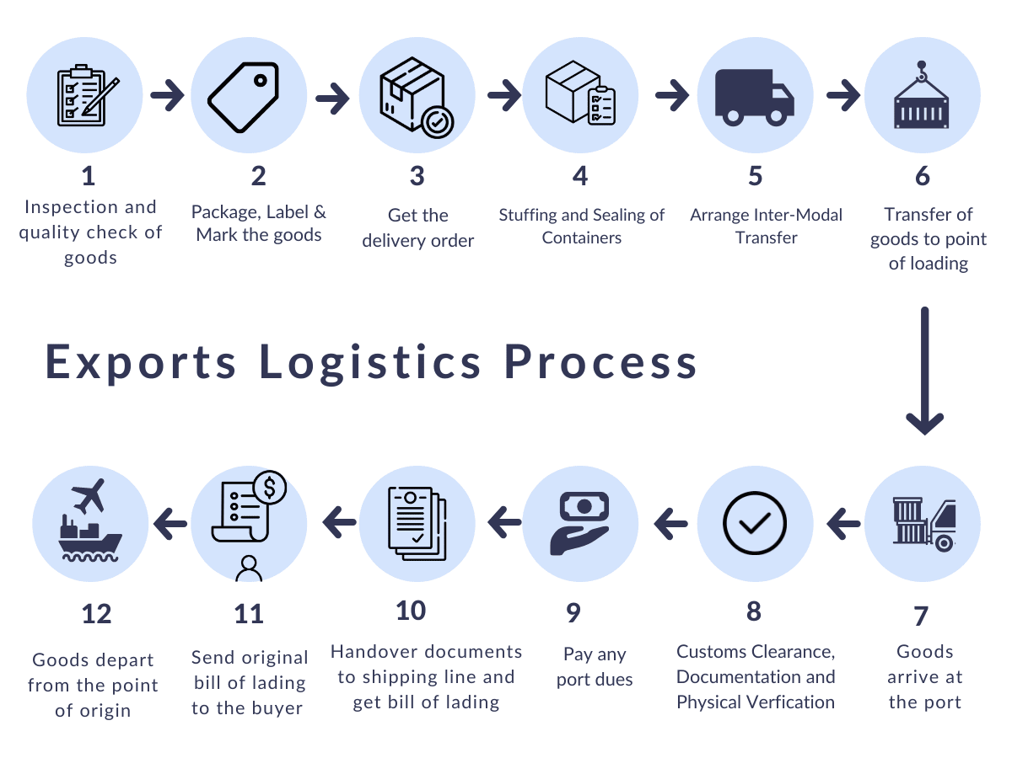
Full Container Process

Slide 20
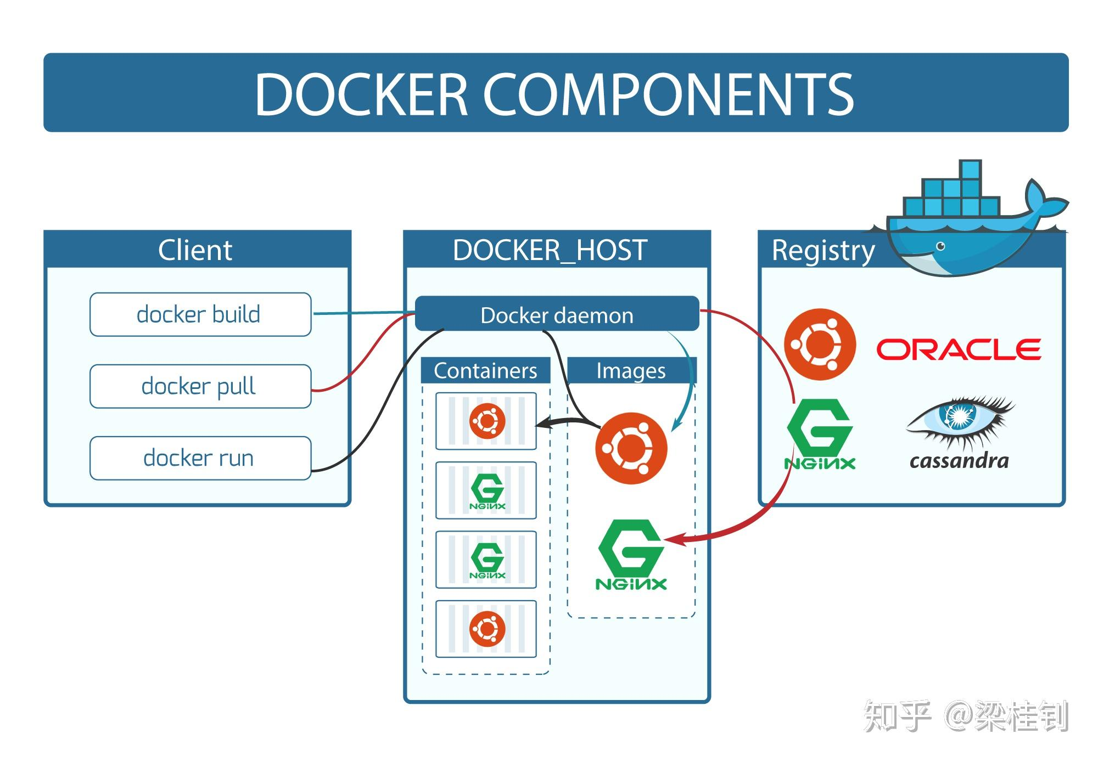
Full Container Process

Slide 21
More About Images

Slide 22
Multi-architecture support
Image tags may include a manifest
Manifest lists which platforms are supported
Docker automatically determines the correct platform

Slide 23
Image Security
Since images are composed of files…
We can scan the files statically (more about this later)

Slide 24
Docker

Slide 25
Container vs Image
Containers run from immutable images
So how are we writing a file???
Each container gets a R/W layer that is shimmed on top of the images
R/W layer saved when container is stopped
Deleted when container is removed

Slide 26
Container Principles
Designed to be short-lived and ephemeral
Stop once their “entry point” finishes
Spin them up / tear them down as needed
Run command always starts a new container
Start/stop work with existing containers

Slide 27
Demo
docker container run -it alpine
echo hello > test.txt
cat test.txt
Use docker desktop to inspect filesystem

Slide 28
Docker cheat sheet

